Slide 1
The importance of real-time gas detection data for proper decision making
Jesús Rubalcava | September 2019

Slide 2
Parent company in Pittsburgh, Pennsylvania 800 employees worldwide focused on preventing deaths due to work-related accidents caused by gas inhalation
Industrial Scientific Corporation
Notes:
Let me know if there are other topics you are interested in covering.

Slide 3
Vision statement
Our goal at Industrial Scientific staff is to stop work-related deaths by year 2050.
Mission
To preserve human life above and below the surface. We want to always provide the highest quality and best costumer service in each of our transactions.
Notes:
Key Points to Make:
We’re dedicating our careers to ending death on the job.
We’re using our 30+ years of gas detection experience as a foundation for broader safety solutions.

Slide 4
✓
✓
I need to avoid complexity, time and human error in the calibration process.
I need accurate calibrations and I need to find a way to automate logs.
Good leaders are good listeners We have demonstrated that we listen to our customers and that we respond to them through innovative products
One-button calibration
Docking station
✓
✓
I need help to provide maintenance to my instrument inventory and to register all the activities.
I need to know all the time where the employees are inside the premises.
iNet Exchange
Wireless gas detector with Wi-Fi and built-in panic or man down alarm in the Accenture 2011 solution.
Notes:
Key Points to Make:
We listen to our customers
Sample Script:
We’ve found is one of the best ways to look at the future is to look at the past. We were built on listening to customer challenges and innovating solutions.
Notes:
You couldn’t bottle H2S with active gas so as a result you were doing one calibration at a time. Used to have to calibrate to each gas and adjust manually. When gases were combined into one cylinder, ISC created a one button calibration so all calibration and adjustments done...Automate and simplify the calibration process (eliminated complexity, errors by building into instrument)
One button calibration does a complete calibration for all gases
Make sure calibrations are done accurately, consistently, eliminate human error, establish automated record keeping (were supposed to record)
Docking Station
Help us automate record keeping, ensure we’re replacing sensors correctly (maintain), did not want to own equipment but they had to. Designed around customer.
iNet Exchange Service
Knowing where employees are on premise
Accenture Life Safety and Man down, panic alarm Ventis LS

Slide 5
Current challenges in gas detection
“I mixed all the reports in my gas detection program and I can’t fail this audit”
“I need a proper way to confirm the use of gas detectors and assign them to the right people”
“It seems impossible to document all the presentations. It implies too many processes and too much paperwork”
“Gas detectors are by far the most complicated PPE. They’re difficult to maintain”
“They can’t be out of service, but maintaining extra detectors costs too much”
Notes:
Other challenges from customers:
Too much time spent on operational tasks associated gas detection programs such as tracking down instruments, educating operators and documenting incidents
Lack of operator accountability for gas detector usage
Poor visibility into how gas detectors are used across different sites and operators
No way to enforce policies for accurate and reliable protection such as regular calibrations and bump tests
Inability to validate that gas detection programs are effective
Insufficient documentation for compliance and incident responses
No historical perspective on gas exposures
Unable to predict or understand the right mix of gas detectors needed

Slide 6
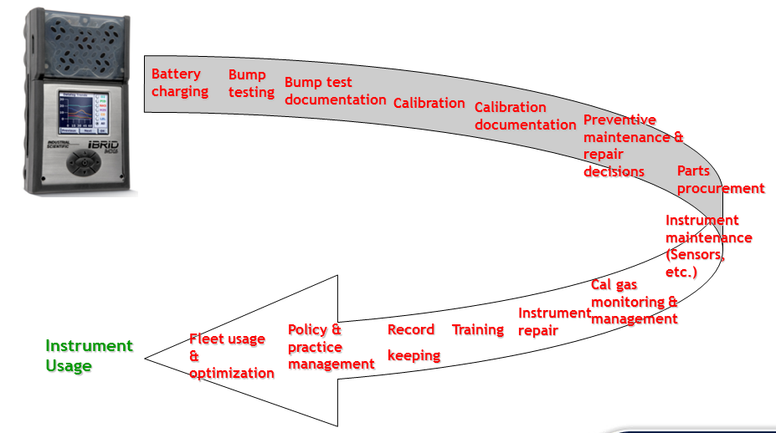
Complex use and maintenance
Típico programa de detección de Gas con gestión interna

Slide 7
iNet Control for gas detection
iNet Control offers: cloud services and applications
iNet is developed and supported by the world’s most famous experts in gas detection
People, teams and risks
Services
Control iNet
Apps
Servicios
Control iNet
e
Gas detector data
Notes:
iNet Parts
On site – this needs to be defined
Change safety to gas detection

Slide 8
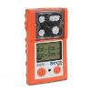
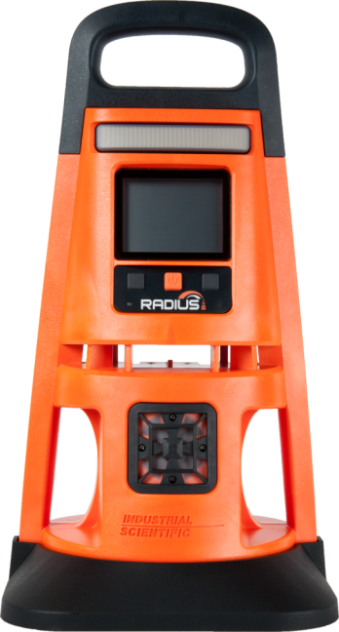
iNet Control facilitates data collection
It works with cloud-based data
Notes:
A data-driven application to ensure gas detection programs are working as designed; that instruments are working properly, that instruments are used properly and that hazardous gas responses are appropriate and timely.
Other benefits:
Make gas detection data accessible and usable
Access gas detection data from any connected device 24x7 using a sleek and intuitive user experience
Work with data; sort, filter, and create reports through a sleek user experience
Eliminate liability and responsibility for gas detection data
Reduce IT costs
Support security and privacy with built-in protection
Automatically upgraded software, just use the app or login via the web
Contact the best in class customer service from Industrial Scientific
Make Gas Detection Programs Easier
Keep track of gas detectors
Assign operators to specific gas monitors
Understand gas hazards, reduce risk
Monitor trends and proactively address before incidents
Reduce thousands of unmanageable alarms to meaningful actionable insight with prescriptive analytics delivered to any mobile device
Demonstrate compliance
Automatically send reports to auditors/stakeholders in any required format covering calibrations, bump tests, usage, alarms and more

Slide 9
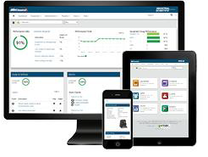
Control iNet
Control iNet helps you to:
Make sure that you have the best gas detection software currently available.
Control iNet is a managing cloud-based application:
Which provides historical data, reports and readings about gas detectors.
Notes:
For safety managers and industrial hygienists, who want to prove they have the best possible gas detection program , iNet Control is a hosted cloud application providing alerts, historical data, recording keeping, and custom reports for gas detection programs including gas exposure history/trends, instrument usage/trends and instrument health.
iNet Control ensures you have the best possible gas detection program. iNet Control is a data-driven approach to ensure that instruments are working properly, that instruments are used properly and that hazardous gas responses are appropriate and timely.

Slide 10
iNet Control facilitates data collection
A cloud-based app for gas detection, which allows you to have additional information
in your instruments:
Generates trust
Knows your instruments
It works with cloud-based data
It knows if your instruments are working properly
If it is being used correctly
It knows what gases are being detected by the instrument.
Reduces risks for workers due to the presence of gas
Notes:
A data-driven application to ensure gas detection programs are working as designed; that instruments are working properly, that instruments are used properly and that hazardous gas responses are appropriate and timely.
Other benefits:
Make gas detection data accessible and usable
Access gas detection data from any connected device 24x7 using a sleek and intuitive user experience
Work with data; sort, filter, and create reports through a sleek user experience
Eliminate liability and responsibility for gas detection data
Reduce IT costs
Support security and privacy with built-in protection
Automatically upgraded software, just use the app or login via the web
Contact the best in class customer service from Industrial Scientific
Make Gas Detection Programs Easier
Keep track of gas detectors
Assign operators to specific gas monitors
Understand gas hazards, reduce risk
Monitor trends and proactively address before incidents
Reduce thousands of unmanageable alarms to meaningful actionable insight with prescriptive analytics delivered to any mobile device
Demonstrate compliance
Automatically send reports to auditors/stakeholders in any required format covering calibrations, bump tests, usage, alarms and more

Slide 11
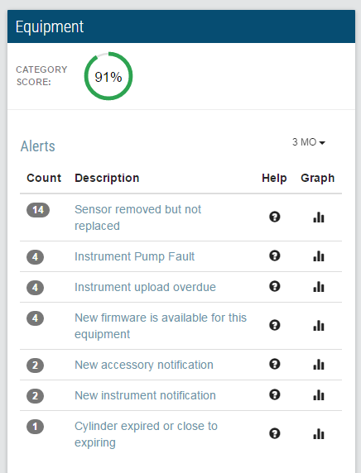
You can trust detectors with
It verifies if the instruments are working correctly:
Event calendar
Schedule verifications and calibrations according to local regulations
Automatic firmware updates
Keeps the firmware updated

Slide 12
You can trust detectors with
Instrument verification and update
It verifies that gas detectors are properly set up
Historical verification / calibration certificates
Guarantees total documentation
Email Alerts
Knows when and what equipment needs attention

Slide 13
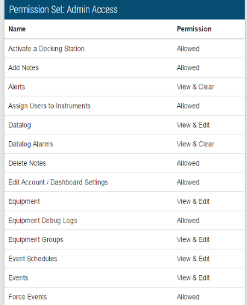
Trust your workers thanks to
Historical instrument assignment
So you can know who is using what instrument and how
Email alerts in case of misuse
The system informs who used an instrument without having verified it, tested it or calibrated it
It knows who turned the instrument off during a critical alarm event
It knows when critical programming was changed

Slide 14
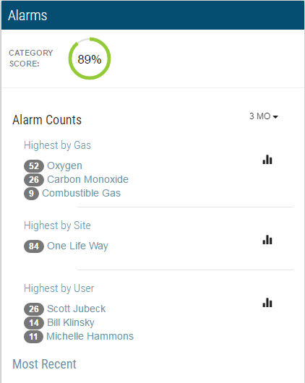
Know the risks with
It verifies exposure to gas
Periodic report through previously established alarms.
E-mail alerts and notification of all alarm events.
Type of gas detected
Length of alarms
Gas peak concentration
TWA of detected toxic gases
Instrument serial
Instrument user
Instrument location by areas.

Slide 15
Know the risks with
Detail history with all gas logs by instrument and user

Slide 16
Sw iNet Control Practical Use Cases
Notes:
A data-driven application to ensure gas detection programs are working as designed; that instruments are working properly, that instruments are used properly and that hazardous gas responses are appropriate and timely.
Other benefits:
Make gas detection data accessible and usable
Access gas detection data from any connected device 24x7 using a sleek and intuitive user experience
Work with data; sort, filter, and create reports through a sleek user experience
Eliminate liability and responsibility for gas detection data
Reduce IT costs
Support security and privacy with built-in protection
Automatically upgraded software, just use the app or login via the web
Contact the best in class customer service from Industrial Scientific
Make Gas Detection Programs Easier
Keep track of gas detectors
Assign operators to specific gas monitors
Understand gas hazards, reduce risk
Monitor trends and proactively address before incidents
Reduce thousands of unmanageable alarms to meaningful actionable insight with prescriptive analytics delivered to any mobile device
Demonstrate compliance
Automatically send reports to auditors/stakeholders in any required format covering calibrations, bump tests, usage, alarms and more

Slide 17
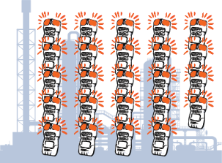
Case
Eliminating the risk
Thanks to iNet and its automated alarm report managers were able to control/eliminate proactively the cause of alarms
On average, 24 alarms were reported manually after each plant stoppage at a refinery
During the next 2 plant stoppages, there were only 2 alarms

Slide 18
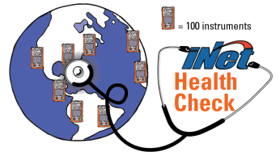
Case – Finding unsafe behavior
Alarm data from 1,000 instruments were reviewed as part of an iNET check
7,000 gas alarms were stored for 12 months
With this information, the Company changed the accident prevention procedure
Out of the 7,000 alarms, over 10% had to do with instruments used by 2 workers

Slide 19
Case – Simplifying verifications and calibrations
A research study on CO discovered that a lot of detectors were used without a verification or calibration routine
The managed started to receive email alerts through iNet when an instrument was used without the maintenance required by the company
The manager established that in case of alert the Company would call the users to remind them the Company’s policies
During the first month of use of the report, 90 alerts were generated. In the last 2 years, less than 5 alerts per month have been reported.

Slide 20
iNet Control statistics
1,738,610,000,000+ Stored logs 52,887,000+ Alarm events
312,600+ Gas detectors
31,400+ Calibration stations 12,200+ Customer sites
* 312,665 gas detectors were estimated as of September 1, 2018
Notes:
We have a proven structure backed by strong data to enhance your safety culture
1,738,610,000,000+ Data Log Readings
52,887,000+ Alarm Events
312,600+ Gas Detectors
31,400+ Docking Stations
12,200+ Customer Sites
16 Years of Experience
81 Countries

Slide 21
iNet footprint worldwide

Slide 22
Customers using
Argentina Australia Austria Azerbaijan Bahrain
Belgium Bosnia and Herzegovina
Brazil
Brunei Canada Chile
China Columbia Czech Republic
Denmark Dominican Republic
Finland
France French Guiana
Germany Ghana Honduras Hong Kong
Iceland
India
Indonesia
Ireland Israel Italy
Japan Madagascar
Malaysia Mauritius Mexico Myanmar
Namibia Netherlands
New Zealand
Norway Oman Pakistan Panama Peru
Philippines
Poland Portugal
Puerto Rico
Qatar
Romania
Russia Saudi Arabia Serbia
Singapore Slovakia
South Africa South Korea Spain Suriname
Sweden
Switzerland
Taiwan
Thailand Trinidad & Tobago
Tunisia Uganda United Arab Emirates
United Kingdom
United States Vietnam

Slide 23
Any questions? Comments? Is this the next step for your company?

Slide 24
Thank you

